Slide 1
Final Engagement
Attack, Defense & Analysis of a Vulnerable Network

Slide 2
Outline of today’s Presentation
This document contains the following resources:
Network Topology
Red Team
Blue Team
Network Analysis Using Wireshark

Slide 3

Network Topology
‹#›

Slide 4
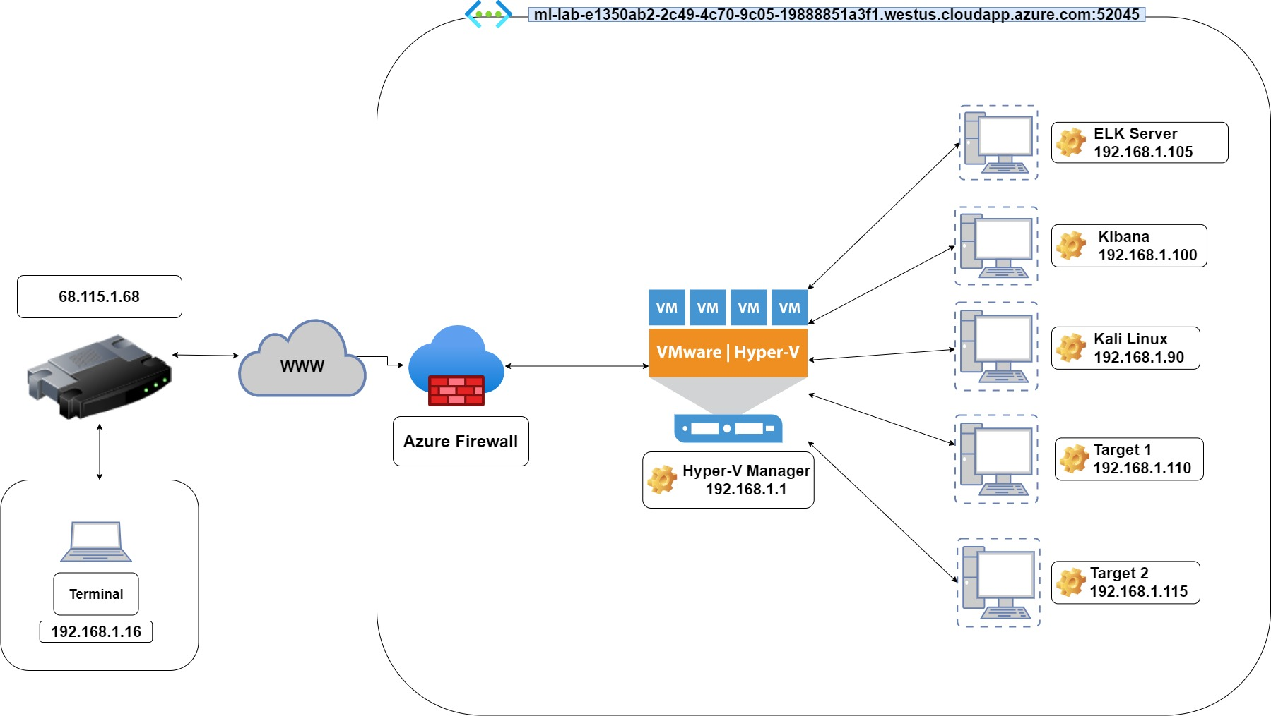
Network Topology
Network
Address Range:192.168.1.1/225
Netmask:255.255.240.0
Gateway:10.0.0.1
Machines
IPv4:192.168.1.105
OS:Windows
Hostname:ELK
IPV4: 192.168.1.100
OS: Windows
Hostname: Kibana
IPv4:192.168.1.90
OS:Linux
Hostname:Kali
IPv4:192.168.1.110
OS:Linux
Hostname:Target 1
IPv4:192.168.1.115
OS:Linux
Hostname:Target 2
Notes:
Here is our network topology. As you can see, we have the Azure lab running with 4 VMs running through Hyper-V Manager. The Vms are the Elk Server, our Kibana, Kali Linux (Attacker machine), Target 1, and Target 2.

Slide 5

Red Team Operations
Presented by: Cheyenne and Tom

Slide 6
Red Team Presentation
This document contains the following resources:
Critical Vulnerabilities
Exploits Used
Avoiding Detect
Maintaining Access

Slide 7
Critical Vulnerabilities
‹#›

Slide 8
Critical Vulnerabilities Target 1:
Vulnerability | Description | Impact
Weak Password Policy | Able to gain access by guessing passwords | Potential remote shell, brute force/dictionary attack
Configuration Files | Incorrect configuration allowed access to company directory and user information | Potential command injection, brute force/dictionary attack
WordPress | Weak password policies as well as misconfigured files | Potential to gain access to WordPress server
Root Escalation | Obtaining password hashes and running a python script | Ability to gain root access
Notes:
Target 1 and target 2 exhibited similar vulnerabilities - dominated by weak password policies and insecure configurations that allowed us easy access to critical files and sensitive information. During our exploit of target 1, we easily guessed user ‘Michael’s’ password, as it was his name, and then used a dictionary attack to crack Steven’s password.
There were 4 main vulnerabilities that we found on Target 1.
Weak Passwords (we were able to simply guess Michael's password (how own name) and run a simple dictionary attack against Steven’s account to gain access to critical information
Incorrect configuration files allowed access to company directories and more sensitive information
WordPress also had weak password policy and misconfigured files which made it easy to access the Wordpress server
Root access was obtained through a python script ran on Steven’s account. This was the ultimate goal of our team.

Slide 9
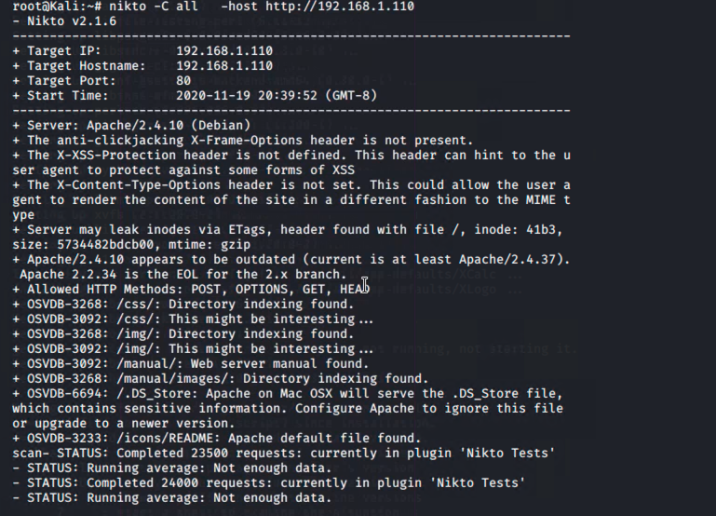
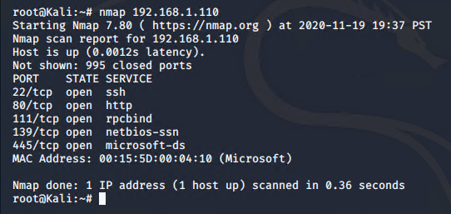
Target 1 Vulnerabilities (cont.)
Fig. 1 - Nikto scan identifies directory listings
Fig. 2 - Port scan identifies open vulnerabilities
Notes:
Here are some screenshots we captured while we were running Nmap and Nikto.
We used Nmap to view which ports were open in an effort to find a way into the system.
We used Nikto to enumerate the web server.

Slide 10
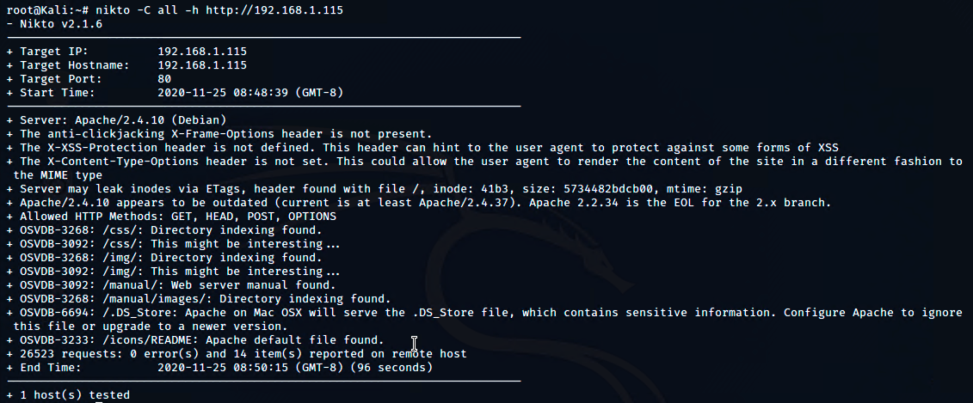
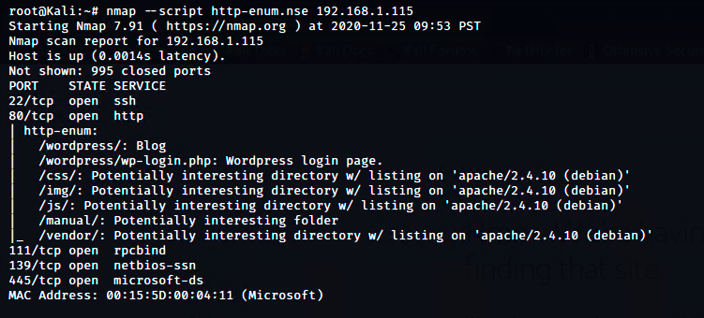
Target 2 Vulnerabilities
Fig. 1 Nikto scan identifies directory listing
Fig 2. nmap scan identifies port vulnerabilities
Notes:
In figure 1 we show our team running Nikto on Target 2 in order to enumerate the webpage and identify directories
In figure 2 we show our team running Nmap in order to show open ports and services

Slide 11
Exploits Used
‹#›

Slide 12
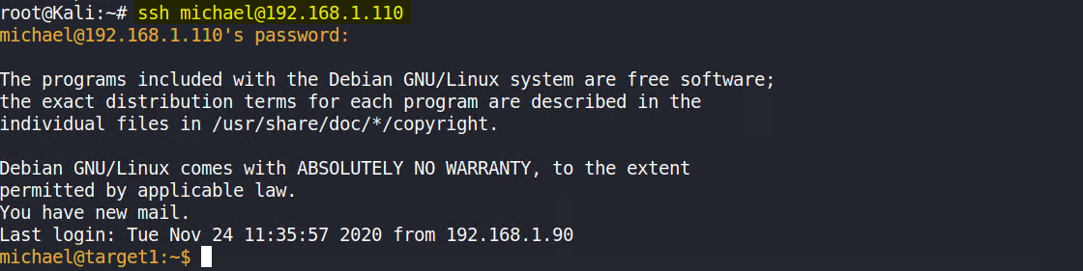
Exploitation: SSH Through Weak Password Policy
Summarize the following:
Exploiting the vulnerability:
SSH was used to login with user “Michael” account
What did the exploit achieve?
User Shell was achieved
Command used: ssh michael@192.168.1.110
Notes:
The first exploit was easily creating an SSH using Michael’s account because of weak password policies.
This was done via port 22 using the SSH command.
Again, there were weak password policies and therefore we easily guessed Michael’s password and gained access to his account.
The command we used was ssh michael@[the target 1 IP]

Slide 13
Exploitation: WordPress Enumeration
Summarize the following:
Exploited the vulnerability using the following tools:
Nmap and wpscan
What did the exploit achieve?
Enumerating users and vulnerable plugins from the wordpress website
wpscan --url http://192.168.1.110/wordpress --enumerate u
Notes:
The next exploit was WordPress enumeration.
We used nmap and wpscan to enumerate users and vulnerable plugins from the wordpress website.
Here we have a screenshot of the command we ran.

Slide 14
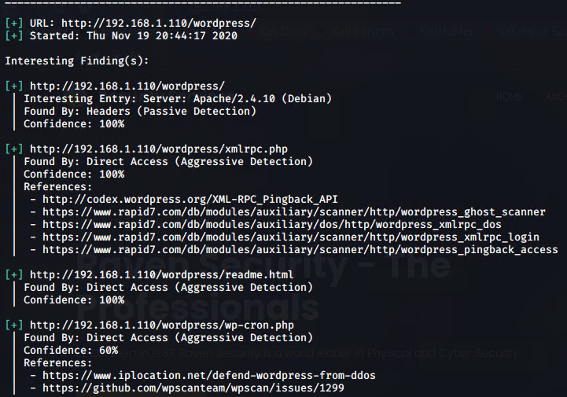
WPscan Results
Notes:
And here we have the results of our wpscan. As you can see, wpscan is used to scan for vulnerabilities, security issues, and plugins used on WordPress.

Slide 15
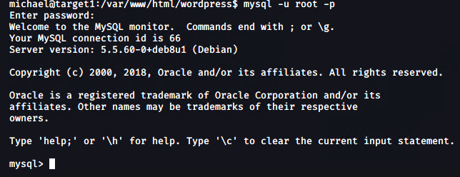
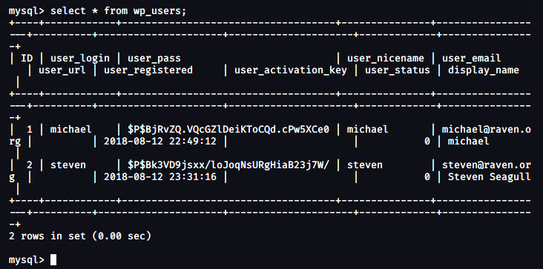
Exploitation: MySQL 5.5
Exploit: mysql -u root -p R@v3nSecurity
mysql → use wordpress;
mysql select * from wp_users
Achievement: Logged into MySQL database, accessed Usernames/password hashes
Notes:
The next exploit was MySql.
In order to get password hashes for Steven’s account, we gained access to MySQL using the shell we created with Michael’s account (as shown in the top screenshot)
There, we found users and their respective password hashes within the wp_users table (as shown in the bottom screenshot)

Slide 16
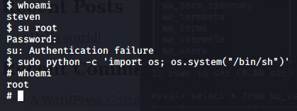
Exploitation: Root Access
While still logged into MySQL, password hashes for another user was found
User: steven
John The Ripper was used to crack the password hash
steven’s password: pink84
Opened another shell with Steven’s account and then ran a python script to gain root access
Notes:
The last exploit was to gain root access.
While still logged into MySQL on Michael’s account, we found another user and his password hash. We saved that hash and ran it with John the Ripper, giving us his password. From there, we created a shell with Steven’s account and used a simple python script to gain root access as you can see in our screenshot.

Slide 17
Avoiding Detection
‹#›

Slide 18
Stealth Exploitation of Excessive HTTP Errors
Monitoring Overview
Which alerts detect this exploit? Excessive HTTP Errors
Which metrics do they measure? http.response.status_code
Which thresholds do they fire at? 400 for the last 5 minutes
Mitigating Detection
How can you execute the same exploit without triggering the alert? Using Gobuster isn’t made for low detection, but it does produce great results
Are there alternative exploits that may perform better? Dirhunt, has better control
Notes:
The first alert we tried to get around was our Excessive HTTP Errors which was a http.response.status_code metric with a threshold of 400 for the last 5 min. Using Gobuster isn't made for low detection even though it produces great results. An alternative exploit would be to use Dirhunt, which is a web crawler that has better control and lower detection.

Slide 19
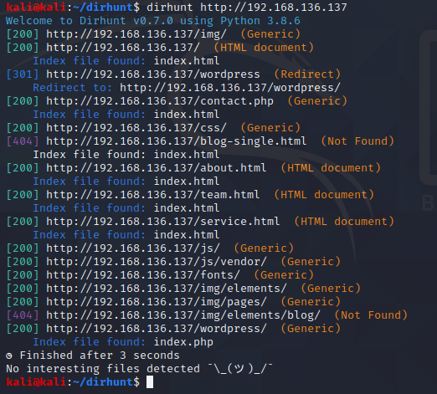
Stealth Exploitation of Excessive HTTP Errors (cont.)
Dirhunt:
Notes:
Here is a screenshot that Chris ran of the webcrawler, Dirhunt, which has lower detection than Gobuster.

Slide 20
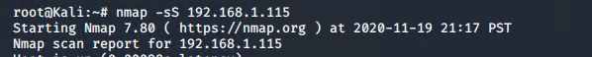
Stealth Exploitation of HTTP Request Size
Monitoring Overview
Which alerts detect this exploit? HTTP Request Size Monitor
Which metrics do they measure? ‘http.request.bytes’
Which thresholds do they fire at? 3500 for the last minute
Mitigating Detection
How can you execute the same exploit without triggering the alert? Running Stealth mode with Nmap, as shown below on Target 2
Are there alternative exploits that may perform better? Set timing to -T1 or -T2 or scan for certain ports only
Notes:
The next alert we wanted to avoid triggering was our HTTP Request Size, a http.request.bytes metric with a threshold of 3500 for the last minute. To mitigate detection, we can run stealth mode on Nmap, as you can see in our screenshot. We could also set the timing by using the -t1 and -t2 flags or scan for only a small amount of ports at a time.

Slide 21
Stealth Exploitation of CPU Usage
Monitoring Overview
Which alerts detect this exploit? CPU Usage Monitor
Which metrics do they measure? system.process.cpu.total.pct
Which thresholds do they fire at? 0.5 for the last 5 minutes
Mitigating Detection
How can you execute the same exploit without triggering the alert? Spreading out requests and scans
Are there alternative exploits that may perform better? Legion (set timing and performance to “paranoid-insane”)
Notes:
The last alert we were trying to avoid was Exploitation of CPU Usage, which uses the system.process.cpu.total.pct metric and has a threshold of .5 events for the last 5 minutes. We can mitigate detection by spreading out requests and scans. An alternative exploit that might perform better would be a tool named Legion.

Slide 22
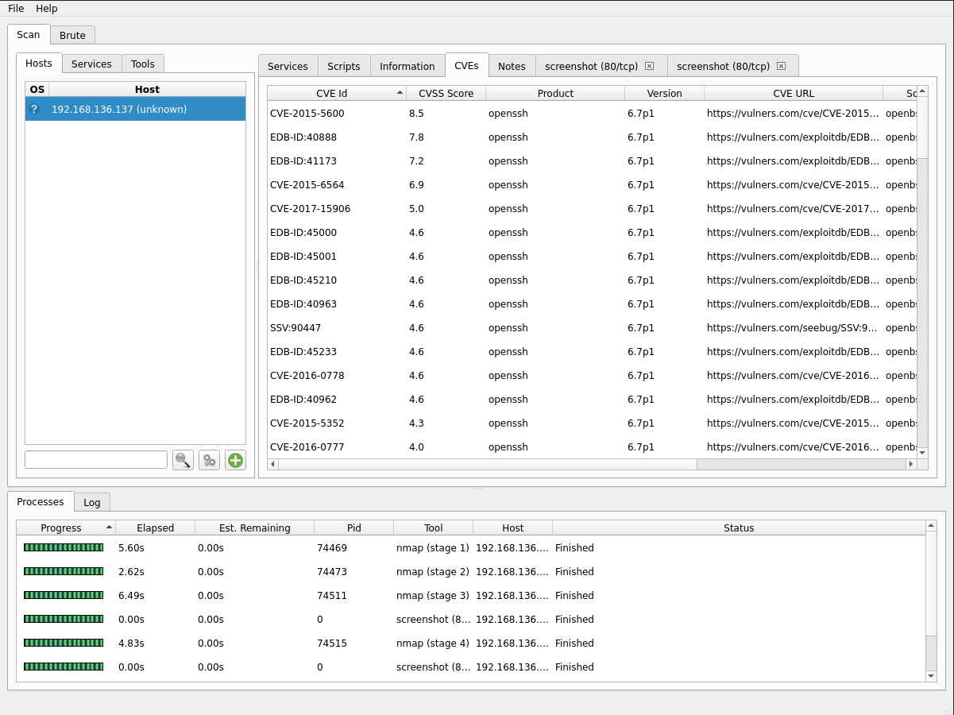
Stealth Exploitation of CPU Usage (cont.)
Notes:
Here we have a screenshot of Legion. You can have it run in different modes which slow down port scanning and packet sending so there is a lower chance of tripping an alert. It auto-runs a ton of recon tools and has them neatly organized on a GUI.

Slide 23
Maintaining Access
‹#›

Slide 24
Backdoor for Target 2
Backdoor Overview
Type of backdoor installed:
reverse shell/backdoor.php with netcat listener
How we dropped it:
command injection attacks using curl
http:192.168.1.115/contact.php
How do you connect to it?
http://192.168.1.115/contact.php?cmd=id
Notes:
We maintained access to Target 2 by using a reverse shell with netcat listener. We did this by command injection attacks using curl. The last bullet point shows how we connected to it.

Slide 25


Blue Team Operations
Presented by: George, Dexter, and Enrique
‹#›

Slide 26
Table of Contents
This document contains the following resources:
Network Topology & Critical Vulnerabilities
Alerts Implemented
Hardening
Implementing Patches
Notes:
For the blue team operations, George, Enrique and I will go over Network topology and their critical vulnerabilities, the alerts that we implemented, hardening against various attacks and issues, as well as implementing patches.

Slide 27
Critical Vulnerabilities: Target 1
Our assessment uncovered the following critical vulnerabilities in Target 1.
Vulnerability | Description | Impact
SSH | 22/tcp OpenSSH | Medium
HTTP | 80/TCP Apache httpd 2.4.10 | High
rcpbind | 111/TCP 2-4 | Medium
netbios-ssn | 130/TCP Samba smbd 3.x - 4.X | Medium
Notes:
SSH keys can present a tremendous opportunity for hackers to gain privileged access to networks, stay connected, impersonate legitimate users, hide their activity with encryption and move freely
For http, the primary reason that you see the “not secure” warning logo is due to the webpage or website not receiving a secure connection. When your web browser, such as Google Chrome, connects to any website, it can either use a secure connection (HTTPS) or HTTP. Any page providing a secure connection will never allow you to see a warning sign. Rcp bind allows remote attackers to cause a denial of service NetBIOS is an inneficient protocol. It is very chatty with lots of broadcasts. When used with its defaults settings, it can be used by the bad guys to gather information about your network and users.

Slide 28
Critical Vulnerabilities: Target 2
Our assessment uncovered the following critical vulnerabilities in Target 2.
Vulnerability | Description | Impact
SSH | 22/tcp OpenSSH | Medium
HTTP | 80/TCP Apache httpd 2.4.10 | High
rcpbind | 111/tcp 2-4 | Medium
netbios-ssn | 139/tcp Samba smbd 3.X - 4.X | Medium
Contact.php | Backdoor Access | High
Notes:
Same as previous slide except with the addition of Contact.php which means that a malicious user can access the back-end database of the web application with SQL injection. This would allow him to do privilege escalations at the application level.

Slide 29
Alerts Implemented
‹#›

Slide 30
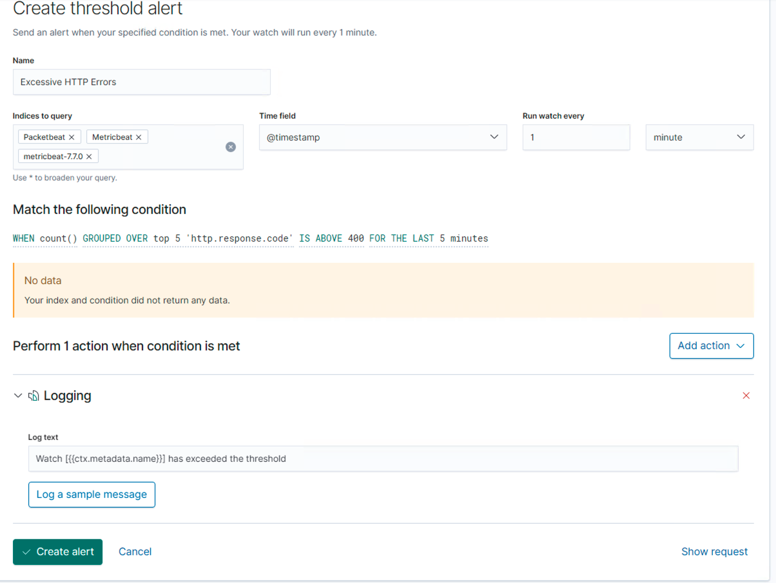
Excessive HTTP Errors
Summarize the following:
Metric: packetbeat-*, HTTP Errors
Threshold: Above 400 for the
last 5 minutes.
Notes:
High number of http request errors can be indicative of a brute force attack

Slide 31
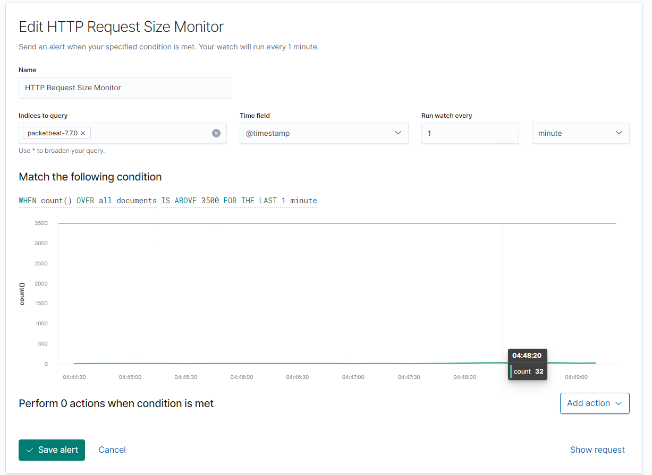
HTTP Request Size Monitor
Summarize the following:
Metric: packetbeat-*http.request.bytes
Threshold: Above 3500 for the last minute.
Notes:
Used as an Indicator of a DOS attack

Slide 32
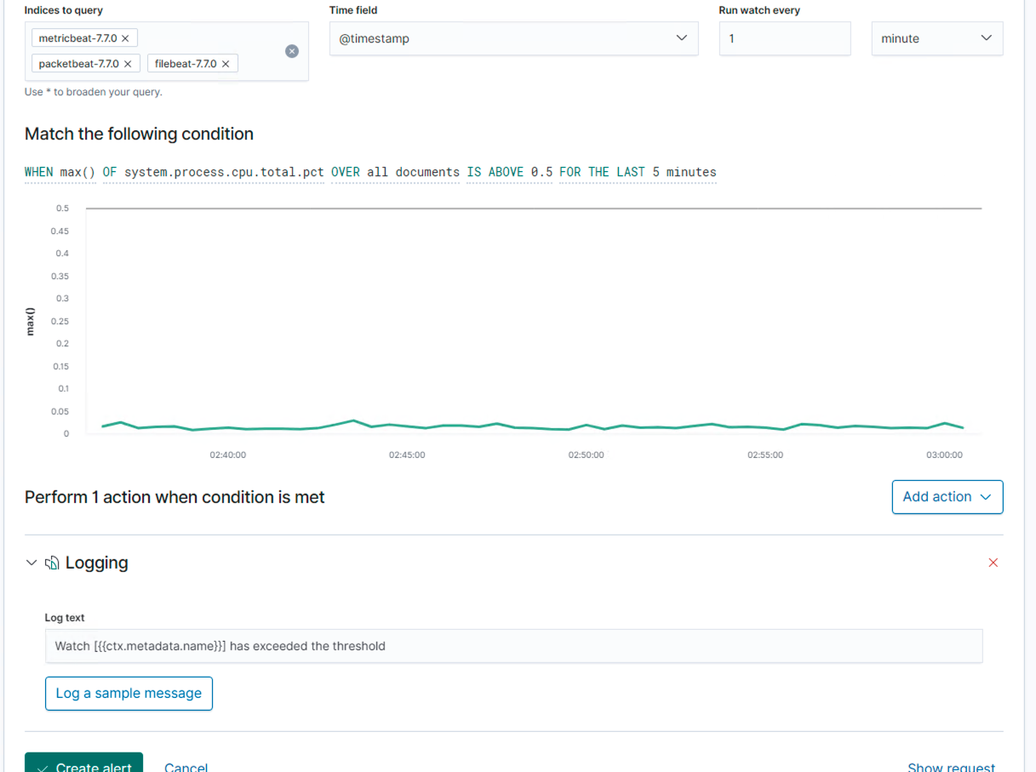
CPU Usage Monitor
Summarize the following:
Metric: metricbeat-*,
system.process.cpu.total.pct
Threshold: Above 0.5 for the
last 5 minutes
Notes:
CPU usage is one of the most important performance metrics in server monitoring. It's the primary value to analyze to determine the processing speed of applications, which is a key performance indicator of network and server health. High CPU usage can be indicative of too many background processes or even malware running in the background sucking up processing power.

Slide 33
Hardening
‹#›

Slide 34
Hardening Against Brute Force Attacks on Target 1
Patch: Invalid credentials lock out
Why the patch works: Prevents excessive login attempts
How to install it: Implementing an account lockout/timeout system
Notes:
Brute force attacks can use automated methods to try millions of password combinations for any user account.
This type of attack can be nearly eliminated by limiting the number of failed sign attempts
A threshold of 10 failed attempts allows users the room to mistype but also stops a brute force attack from guessing a users password

Slide 35
Hardening Against DOS Attacks on Target 1 and 2
Patch:
Whitelisting IP Addresses. Load Balancer
Why the patch works:
Accepts connections strictly from trusted IP address ranges. The load balancer will distribute the traffic to the servers thereby optimizing both the network traffic and processing.
How to install it:
Set Whitelisting list in Network/Firewall settings.
Configuring /etc/hosts.allow config file on linux machines to allow certain hosts access to certain services.
The load balancer can be installed as hardware in front of the servers in the data order.
The load balancer can also be installed as software via an application.
Notes:
Dos attacks is a malicious attempt to make an online service unavailable to users, usually by temporarily interrupting or suspending the services of its hosting server.
Allowing legitimate IP adresses and blocking ones from known attackers is one of the simplest defense against this attack

Slide 36
Hardening Against Excessive CPU Usage on Target 1 and 2
Patch:
Creating alerts at different thresholds of CPU Usage, limiting the max CPU usage for each core.
Why the patch works:
The alerts focus on the amount of activity occurring on the CPU. It sets a limit on the amount of CPU Usage.
How to install it:
Create an alert at 75% and one at 100% CPU Usage
Install software that limits CPU Usage
In Task Manager limit the cores a process is allowed to use.
Notes:
Scheduled virus scans can help detect and eliminate malicious files from your machine

Slide 37
Hardening Against Remote Access on Target 2
Patch:
Update Kernel
Why the patch works:
This certifies that everything is up to date.
How to install it:
sudo apt-get upgrade kernel
sudo reboot

Slide 38
Hardening Against Remote Access on Target 2
Patch:
Canonical Livepatch
Why the patch works:
Livepatch updates software as soon as it is released.
How to install it:
sudo snap install canonical-livepatch
sudo canonical-livepatch

Slide 39
Hardening Against Remote Access on Target 2
Patch:
KernelCare
Why the patch works:
It automatically downloads and applies new kernel security patches without rebooting the server.
How to install it:
wget -qq -O -- https://kernelcare.com/installer | bashsudo /usr/bin/kcarectl --register <your key>

Slide 40
Implementing Patches
‹#›

Slide 41
Implementing Patches with Ansible
Playbook Overview
Ansible is an open-source tool that is agentless and does everything through standard SSH. It provides automation, configuration, management, and orchestration all in one. The patching is customizable via role's
variables definition.
Run:
ansible-playbook orapatch.yml -k
The "-k" option will prompt you to enter the SSH password.
If you're using SSH keys then "-k" option can be omitted.

Slide 42

Network Analysis
‹#›

Slide 43
Table of Contents
This document contains the following resources:
Traffic Profile
Normal Activity
Malicious Activity
The End
Notes:
Sergio and I will be going over the network analysis. This will include the traffic profile, as well as distinguishing between normal and malicious activity, and understanding what these activities entail. All packet analysis was done with wireshark, and everything else was researched online.

Slide 44
Traffic Profile
‹#›

Slide 45
Traffic Profile
Our analysis identified the following characteristics of the traffic on the network:
Feature | Value | Description
Top Talkers (IP Addresses) | 172.16.4.205 (16 MB) 166.62.111.64 (15 MB) 10.0.0.201 (8,493 kB) | Machines that sent the most traffic.
Subnets | 10.0.0.0 10.6.12.0 172.16.4.0 | Observed subnet ranges.
Most Common Protocols | UDP TCP HTTP TLSv1.2 and 1.3 | Three most common protocols on the network.
# of Unique IP Addresses | 810 | Count of observed IP addresses.
# of Malware Species | 1 | Number of malware binaries identified in traffic.
Notes:
To begin profiling the traffic, we opened up the Wireshark-Conversations table from the Statistics tab. Using this table we used the IPV4 tab and sorted by the total size of packets being sent to identify the top talkers. Then we scrolled through the same IPV4 tab to spot patterns in the IP addresses to identify the subnets. For the most common protocols we opened up the ProtocolHierarchy table in the Statistics tab. This table displays the top protocols being used according to the number of packets and their relative size. We then used tshark on a terminal to extract the total number of unique IP addresses from our pcap file. And finally we noticed some unusual activity that lead us to find an http get request for a known malicious file called “june11.dll”. This was the only known malware species we identified.

Slide 46
Behavioral Analysis
Purpose of Traffic on the Network
Users were observed engaging in the following kinds of activity.
“Normal” Activity
Watching YouTube, Time.com ezine, personal projects, personal shopping, news sites
Malicious Activity
Set up AD network domain controller
Downloading malware
Torrenting entertainment media
Drug use and sourcing website
Notes:
In our behavioral analysis, we distinguished between normal and malicious activity. Under the normal but rather time wasting category, we found activity such as watching Youtube, reading the news, online shopping etc. And what we categorized as malicious included activity such as setting up a webserver with an active domain controller on the company network, inadvertently downloading malware, torrenting entertainment media, and visiting a website related to illegal drugs.

Slide 47
Normal Activity
‹#›

Slide 48
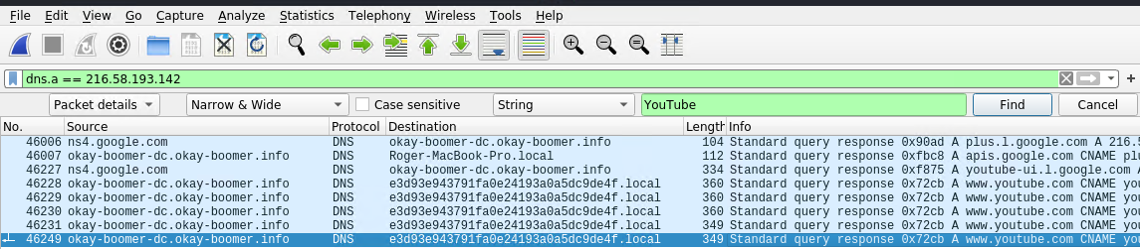
Watching YouTube
● They had a lot of traffic to YouTube IP addresses using protocols like TCP and HTTP
● The users were steaming packets from specific youtube IP addresses like 216.52.193.142

Slide 49
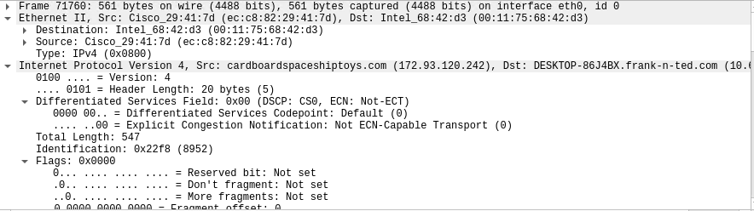
Personal Shopping
Visiting cardboardspaceshiptoys.com
Shows personal shopping being worked on during working hours.

Slide 50
Time.com
Visiting Time.com
Shows non-work related browsing during working hours.

Slide 51
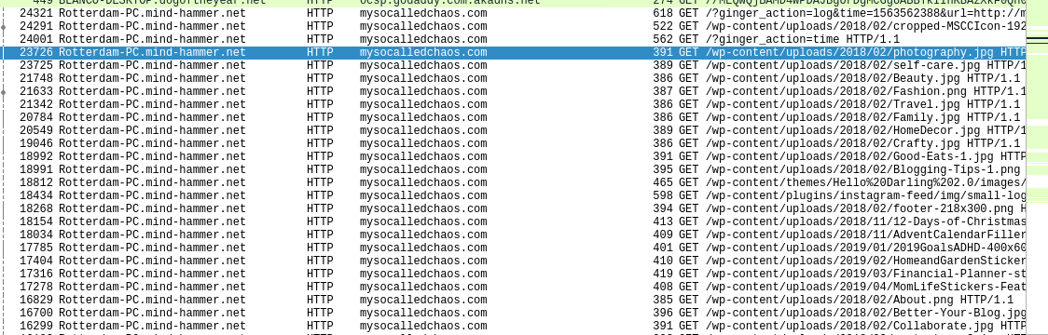
Personal Projects
mysocalledchaos.com
Personal WordPress Site being worked on during working hours.

Slide 52
Malicious Activity
‹#›
Notes:
Now we will be covering the malicious activity

Slide 53
Exposed Corporate Network with Personal DC
Summary:
Users set up their own web server on the corporate network
frank-n-ted.com
Users were using this host to bypass company policy
Time was wasted on sites like YouTube
Connections were made with untrusted sites
malware was consequently downloaded
Notes:
Our first concern was the creation of a DC inside in the corporate network. In summary the users set up their own webserver on the network under the name frank-n-ted.com. We assume that they set this up to bypass company policy, but this resulted in the users wasting time on sites like youtube and visiting untrusted sites where malware was consequently downloaded.

Slide 54
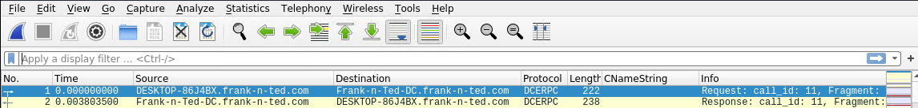
Exposed Corporate Network with Personal DC
Proof of unauthorized Domain Controller on corporate network:
Notes:
Here we can see proof of their personal DC for frank-n-ted.com.

Slide 55
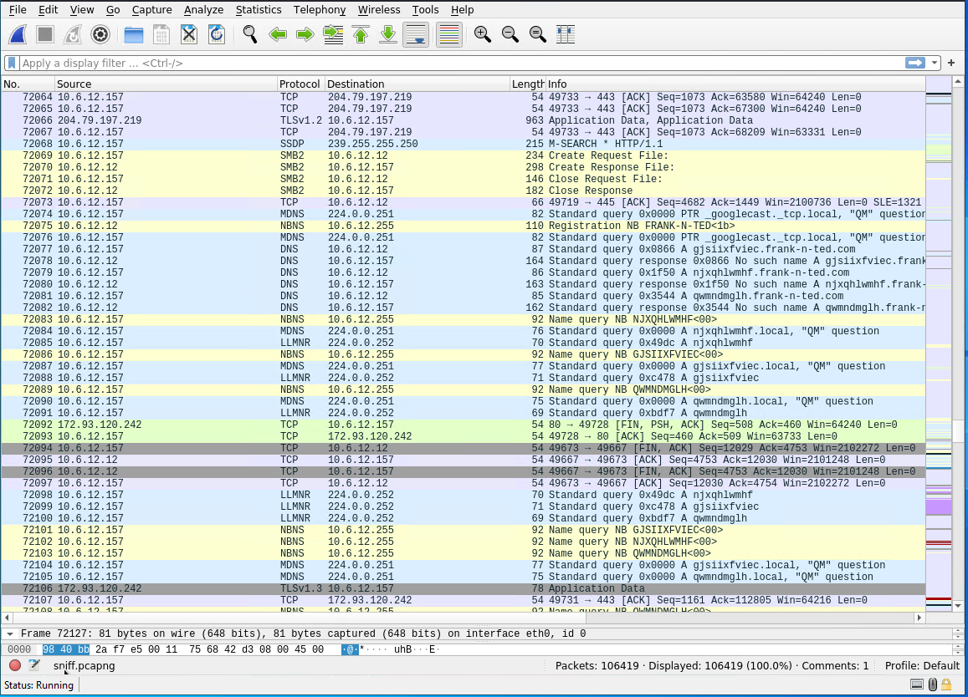
Exposed Corporate Network with Personal DC
Notes:
At the top of this screen capture we can see IP 204.79.197.219 which is a Microsoft address used by the Skype protocol. We can then see a dramatic uptick in DNS name queries from Frank-N-Ted’s DC pinging the network. This could be indicative of malicious traffic using a known flaw in Skype and should be investigated further.

Slide 56
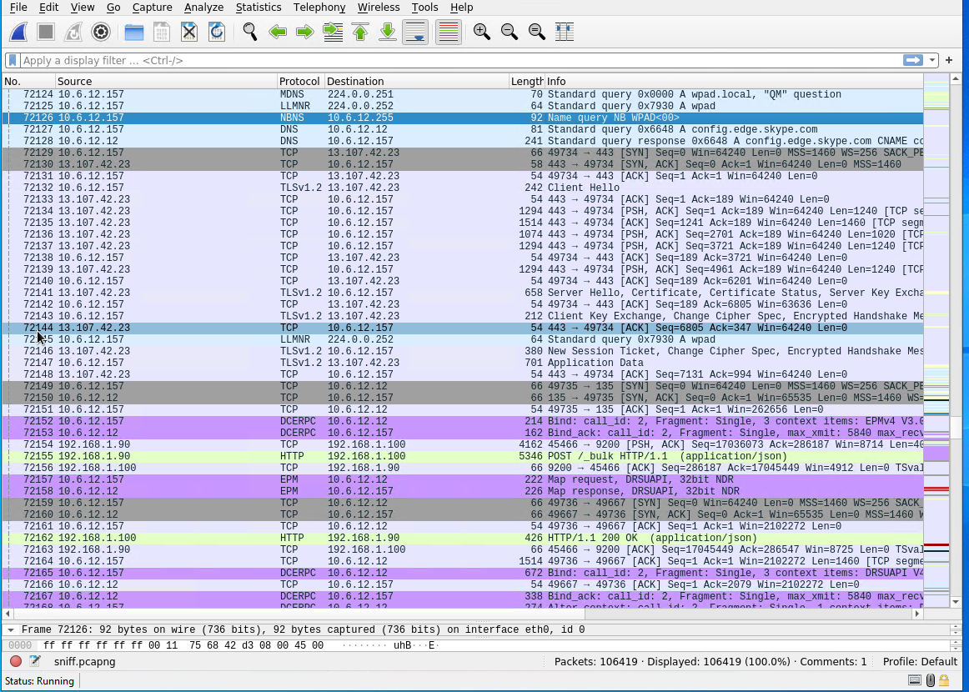
Exposed Corporate Network with Personal DC
Skype Installation:
Notes:
On this slide we can see additional skype application traffic that is TCP and not UDP which shows that this is not call traffic but rather application traffic.

Slide 57
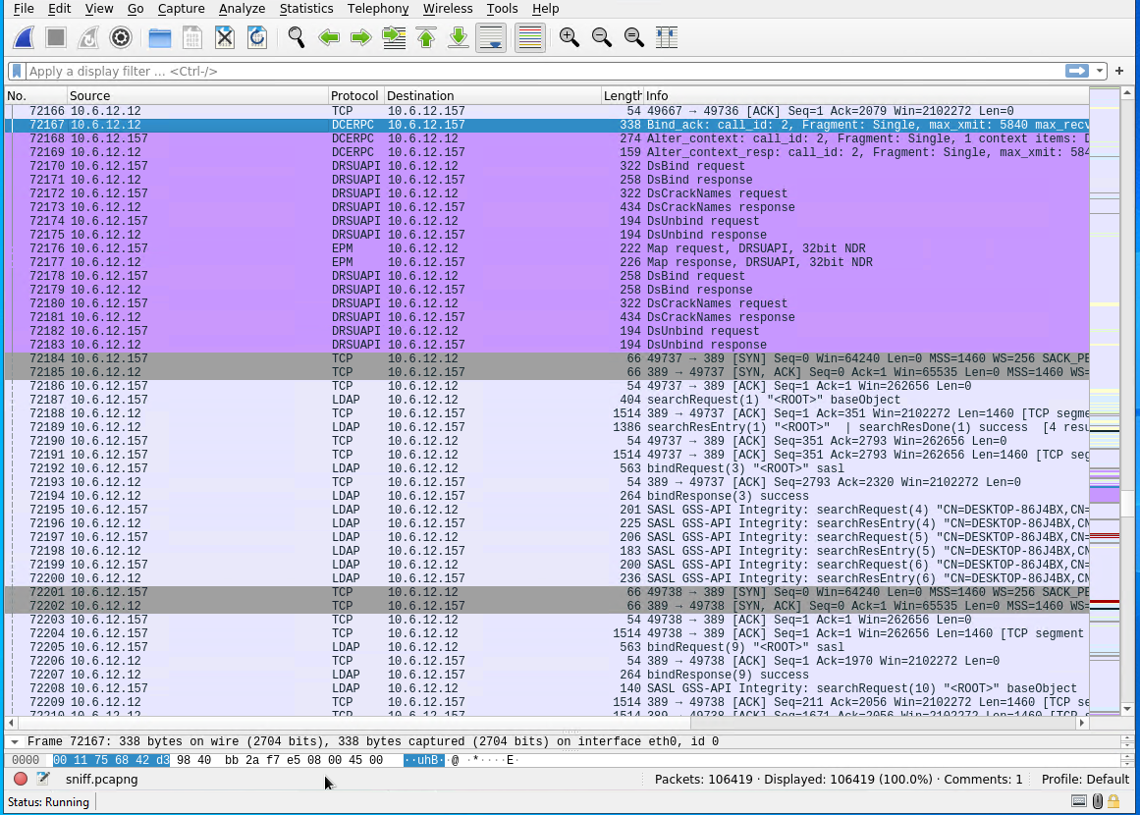
Exposed Corporate Network with Personal DC
DC and AD setup Traffic:
Notes:
Here we have the DC and AD setup traffic. This slide shows an uptick in traffic from the DC to a Desktop machine on the Domain. What’s interesting is the DRSUAPI traffic, which is used to keep an Active Directory on a network stable when multiple DC’s are present. This traffic leads us to the SASL GSS-API traffic, which is a protocol to extract data from a Hadoop service. Upon further inspection this is benign DC setup traffic with Windows Update.

Slide 58
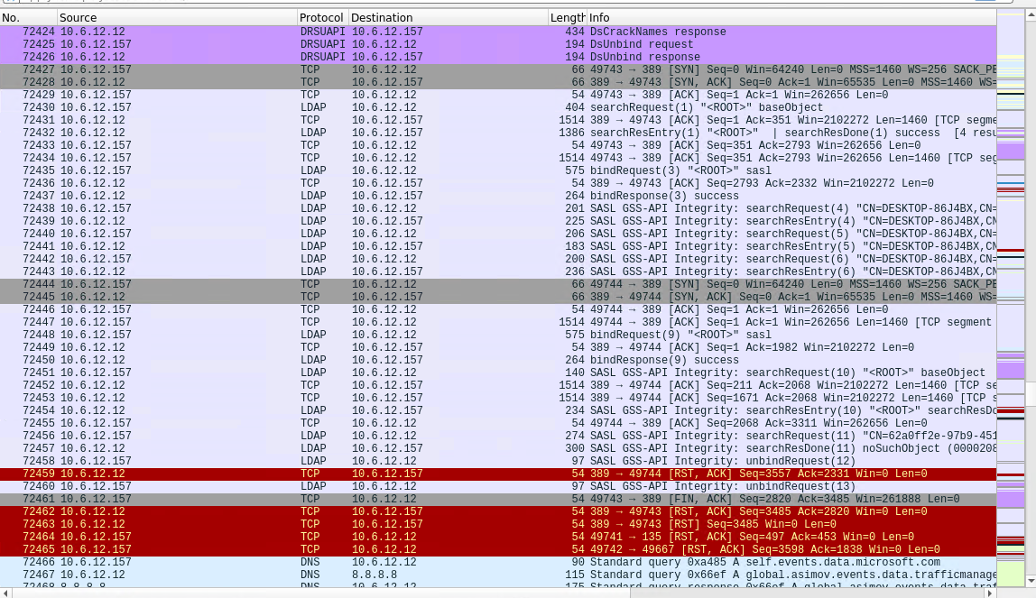
Exposed Corporate Network with Personal DC
Windows Update and software Install:
Notes:
and here we can see the Windows Update

Slide 59
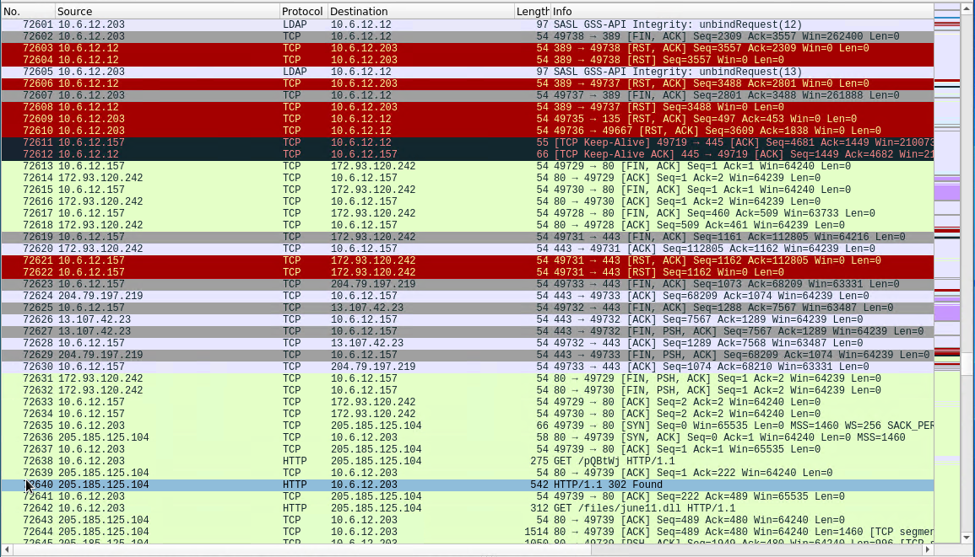
Exposed Corporate Network with Personal DC
Point of infection:
Notes:
Now we get to the point of infection. Here we can see the GET request that downloads the Trojan june11.dll. Upon deeper inspection of the source IP we find an IP that has been shutdown due to non-payment by the owner. Using the wayback machine we discovered that the site was being used to host adult content of an Animated, Japanese persuasion. Virustotal.net flagged the IP as a known host for Trojans and Malware. Additionally, the IP of 172.93.120.242 was also found to be of the same type of content using the wayback machine.

Slide 60
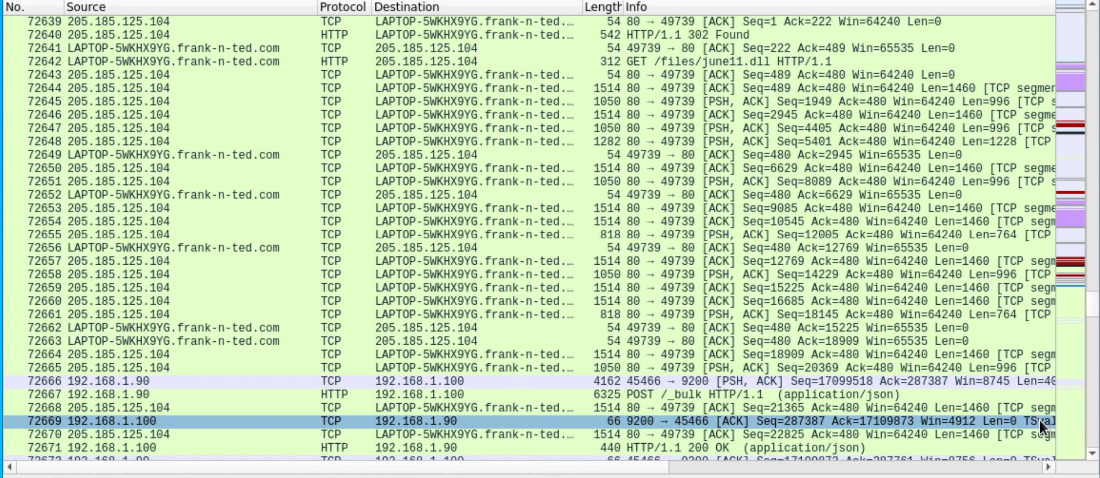
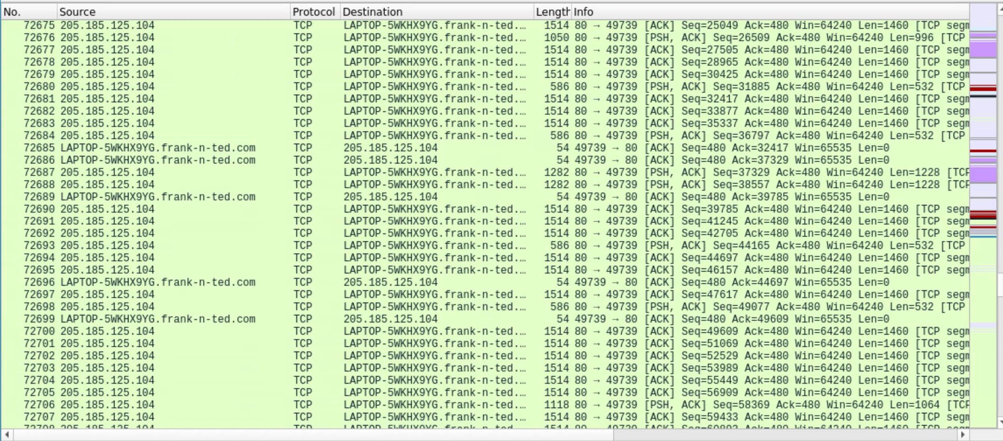
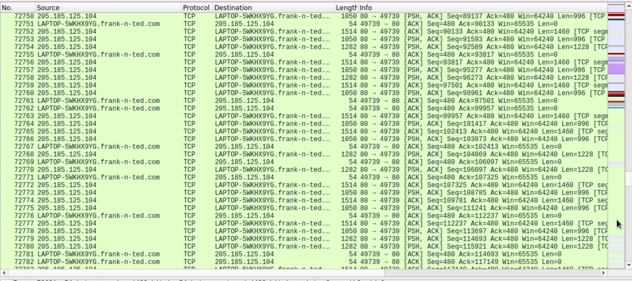
Exposed Corporate Network with Personal DC
Continued Browsing:
Notes:
And here we have evidence that the initial visit to this site was not unintentional, as there were over 60,000 captured packets of traffic to this site.

Slide 61
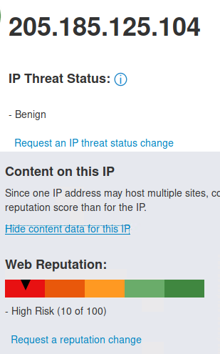
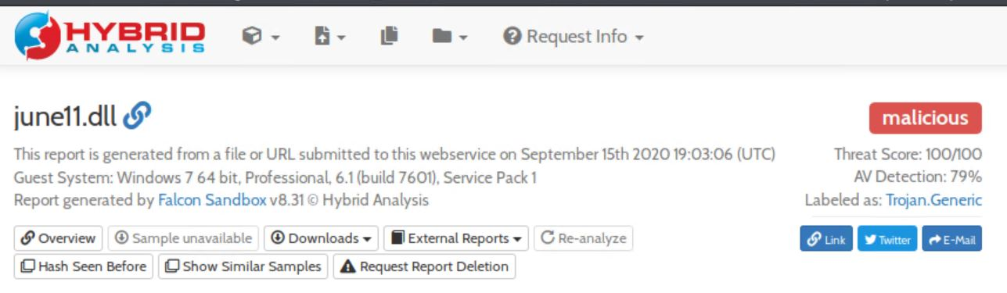
Exposed Corporate Network with Personal DC
Analysis of infection with “june11.dll”:
LAPTOP-5WKHX9YG.frank-n-ted.com HTTP-GET from 205.185.125.104
According to Webroot this site has a malicious reputation with a risk level of 90%
“june11.dll” was downloaded to the users machine from this site
According to Hybrid Analysis, the file has the following properties:
Antivirus vendors have classified it as a malicious trojan
10 suspicious indicators such as anti-reverse engineering and contacts random domain names
Notes:
After we determined the process of infection, we decided to learn about the actual malicious file, “june11.dll”. We learned that the site that this file was downloaded from, 205.105.125.104, has a malicious reputation with a risk level of 90%. We also learned that the june11.dll file has been classified as a malicious trojan with indicators such as anti-reverse engineering and contacting random domains for get requests.

Slide 62
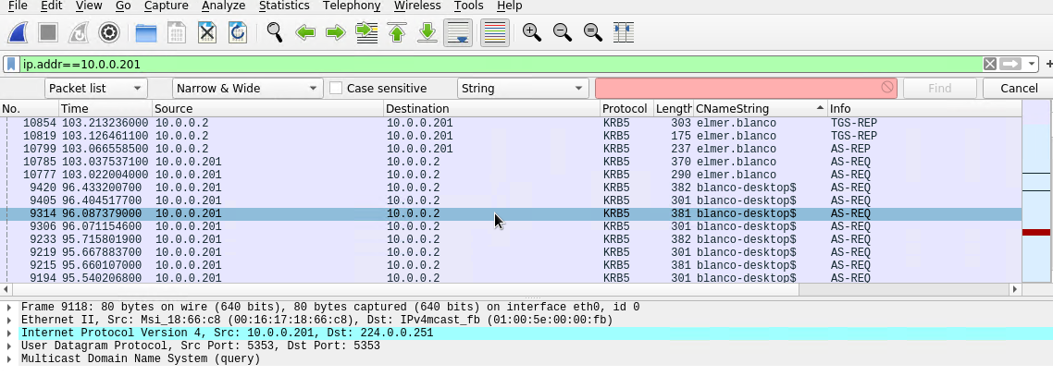
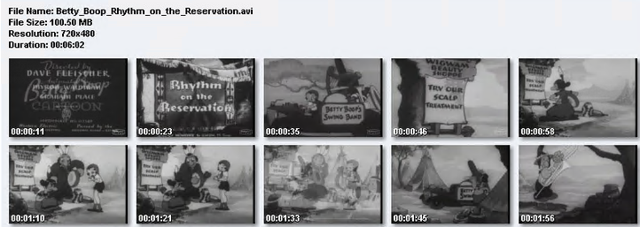
Torrenting Entertainment Media
Summary:
Violation of company torrenting policy
BLANCO-DESKTOP HTTP-GET from files.publicdomaintorrents.com
The user was browsing for entertainment media
Used BitTorrent to download Betty_Boop_Rhythm_on_the_Reservation.avi.torrent
Notes:
We also came across an instance of a user downloading entertainment media. This is a violation of company policy that states torrenting is restricted for legitimate purposes such as downloading operating systems. We identified the user as elmer blanco. He visited a website called publicdomaintorrents where he used BitTorrent to download a 6 minute episode of Betty Boop. Clearly this was an illegitimate reason to torrent, and poses a risk to the company because malware can be hidden in these types of files.

Slide 63
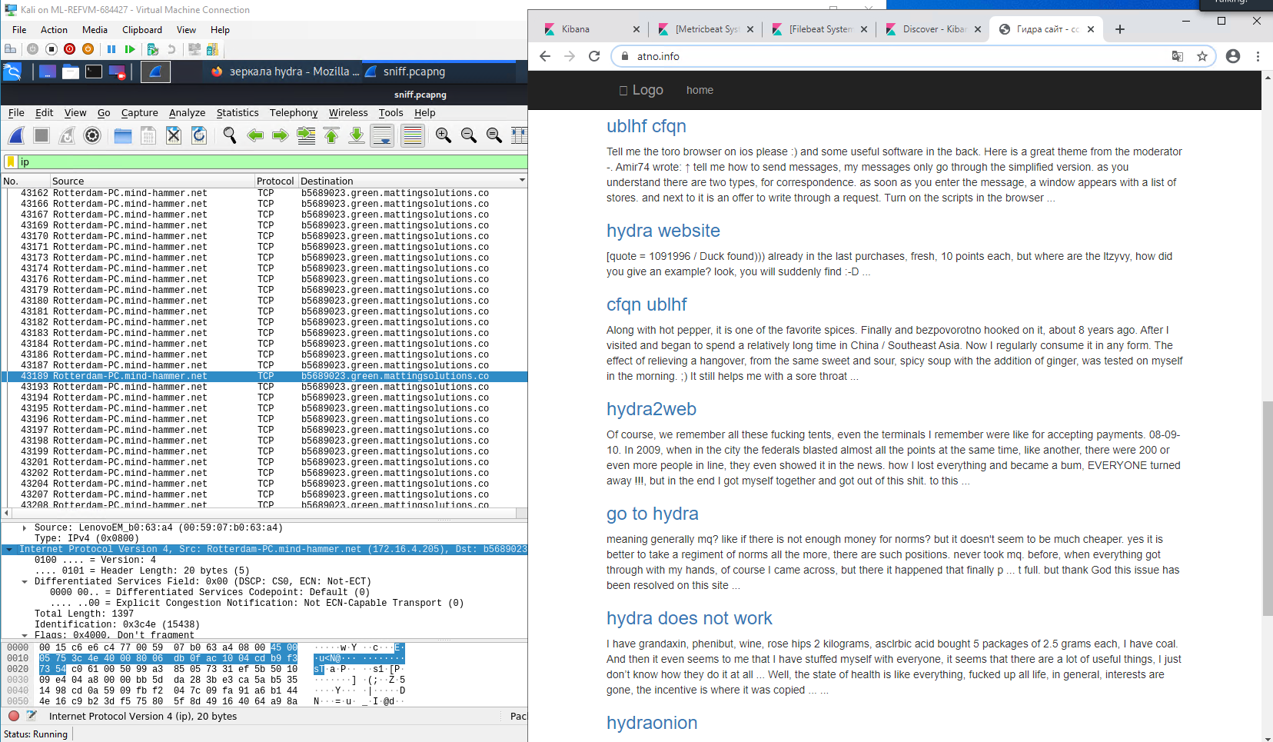
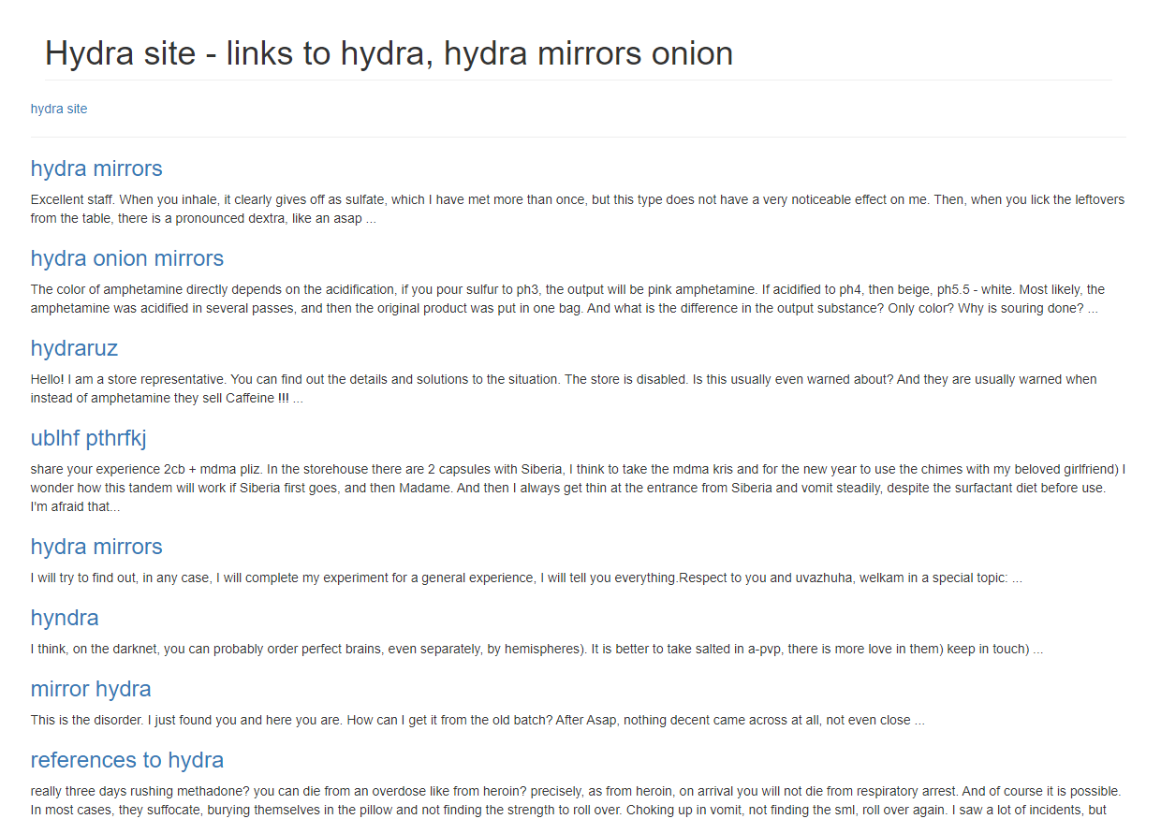
Illegal Activity
Summarize the following:
Russian Site pertaining to illegal drug use, procurement, and testing avoidance.
green.mattingsolutions.co redirects to atno.info
Notes:
Finally, we noticed an unusual amount of TCP traffic being directed to green.mattingsolutions.co. When we investigated this, we found out that this site redirects to atno.info which was a russian site with information regarding illegal drug activity. When you translate from russian to english you can see users inquiring about where to get drugs, and things of that nature. This kind of web browsing does not belong in the workplace.

Slide 64
The End
‹#›
Notes:
That wraps up our presentation, thank you for time. We’ll now open up for Q and A.

